Slide 1

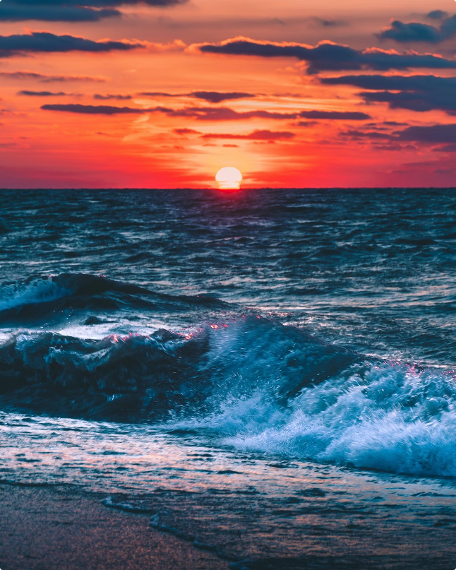
Image Classification Project
This presentation outlines an image classification project, exploring the development of a deep learning model for classifying images and deploying it as a web application.
Paras Borase
Machine Learning July Batch

Slide 2

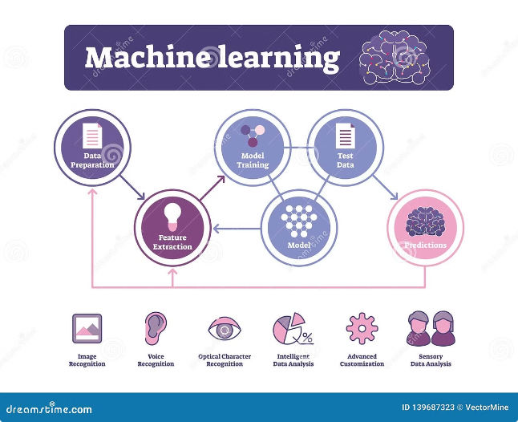
Project Objective
The primary goal is to build a robust image classification system using Convolutional Neural Networks (CNNs). This system will utilize the power of deep learning to accurately categorize images into predefined classes. Additionally, the project aims to create a user-friendly web application powered by Flask, enabling seamless interaction with the trained model.
Deep Learning Model
Flask Web Application
Employ a Convolutional Neural Network (CNN) architecture for image classification. CNNs are renowned for their ability to extract intricate features from images.
Develop a Flask web application to serve as an interface for the image classification model. The web application will allow users to upload images and receive classification predictions.

Slide 3

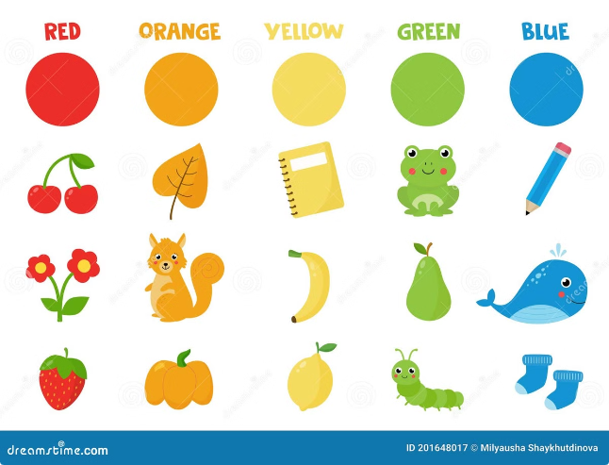
Dataset Overview
The CIFAR-10 dataset serves as the foundation for training and evaluating the image classification model. This dataset contains a rich collection of images categorized into ten distinct classes.
1
CIFAR-10 Dataset
2
Ten Classes
A widely used dataset in computer vision, comprising 60,000 color images.
The dataset includes ten distinct classes, including airplane, automobile, bird, cat, deer, dog, frog, horse, ship, and truck.
3
Data Split
The dataset is split into 50,000 images for training and 10,000 images for testing, ensuring a balanced evaluation of the model's performance.

Slide 4
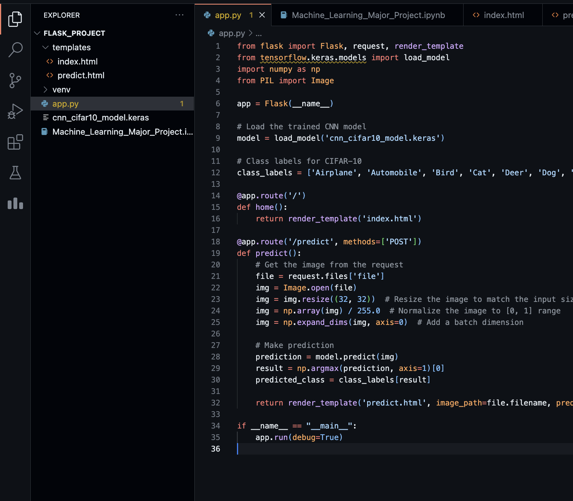
Data Preprocessing
Normalization:
Pixel values scaled between 0 and 1.
One-Hot Encoding:
Conversion of class labels into binary matrices.
Data Augmentation:
Techniques used to enhance the dataset, including rotation, shifting, and flipping.

Slide 5
CNN Model Architecture
Layers Overview:
Input Layer: 32x32x3 image dimensions.
Convolutional Layers: Feature extraction using filters.
Max Pooling: Down sampling for dimensionality reduction.
Flatten Layer: Converts 2D matrix to 1D vector.
Dense Layers: Fully connected layers for classification.
Dropout: Regularization technique to prevent overfitting.
Output Layer: SoftMax activation for class prediction.

Slide 6
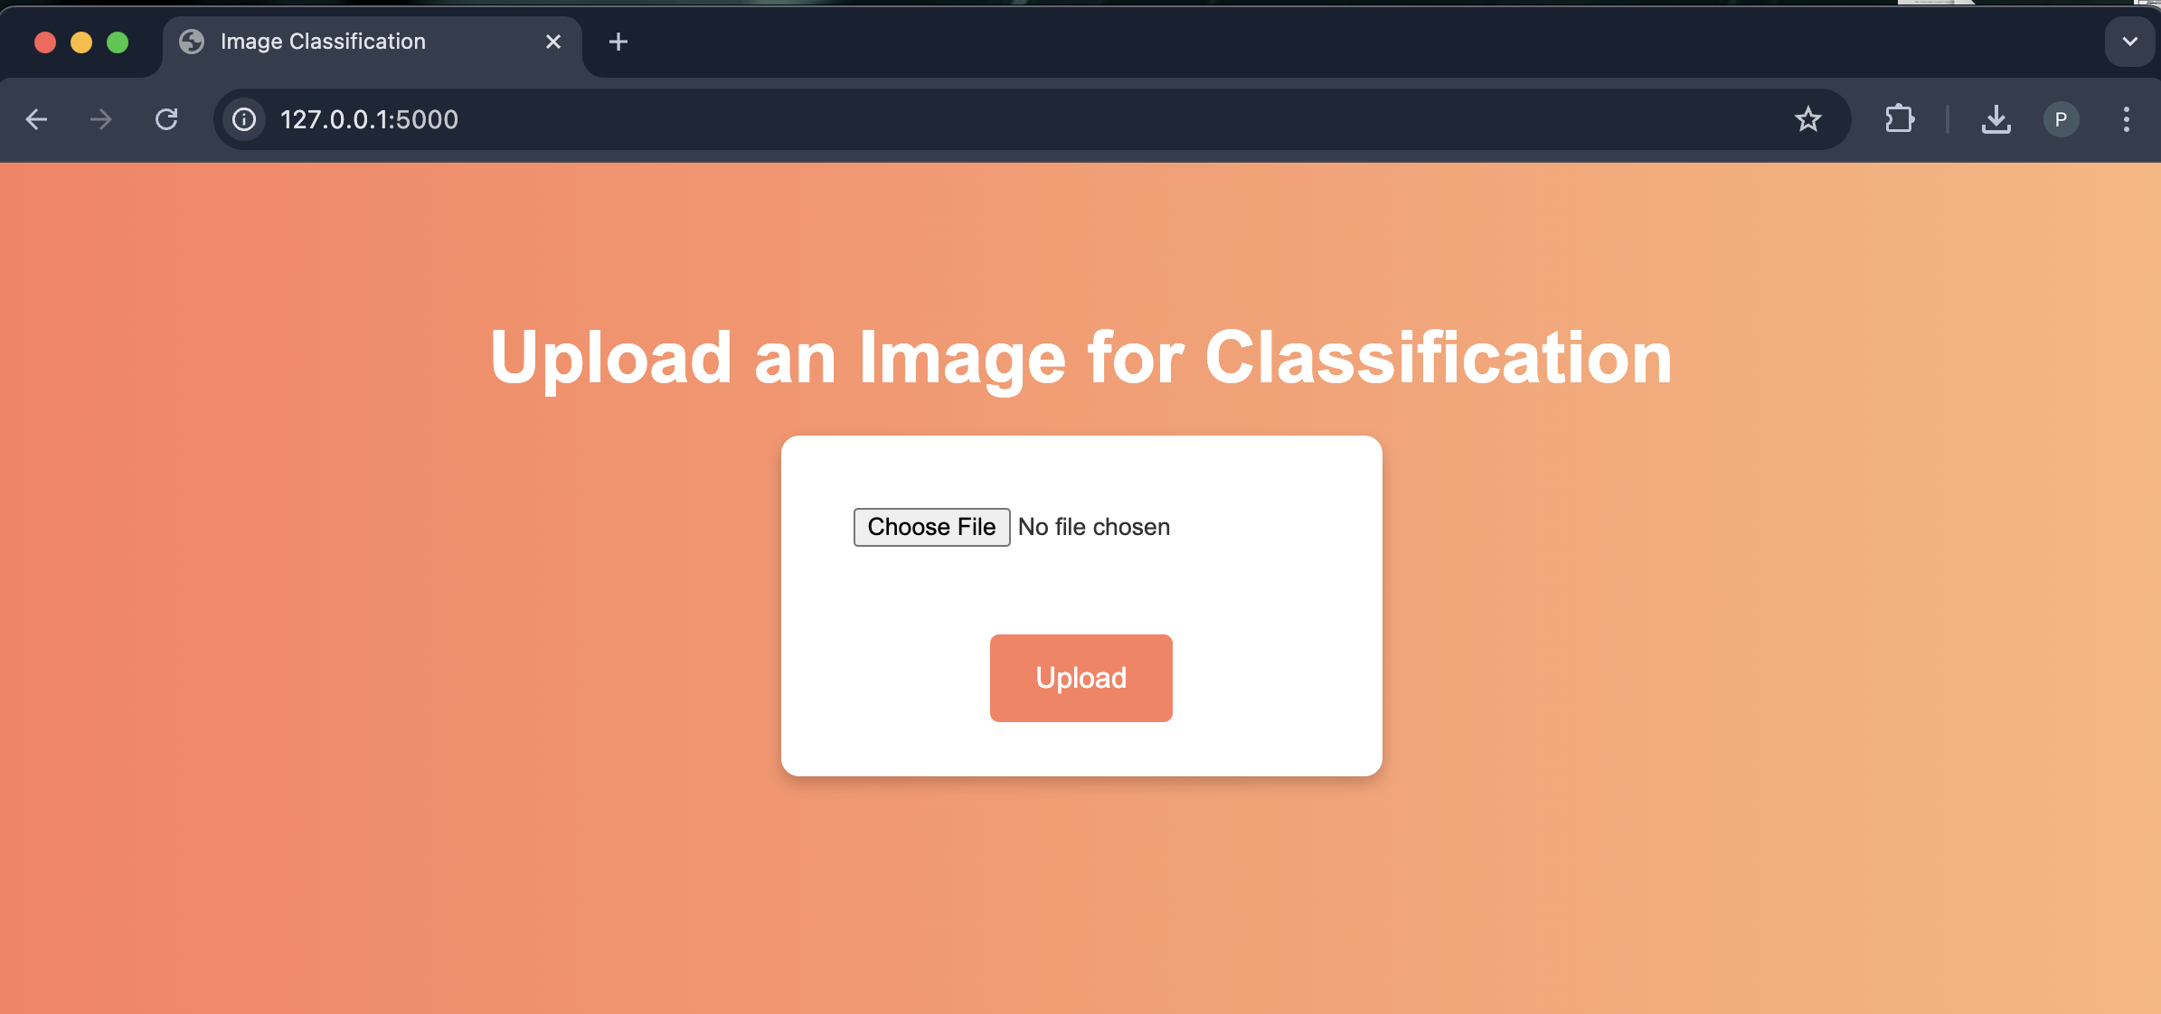
Demonstration

Slide 7
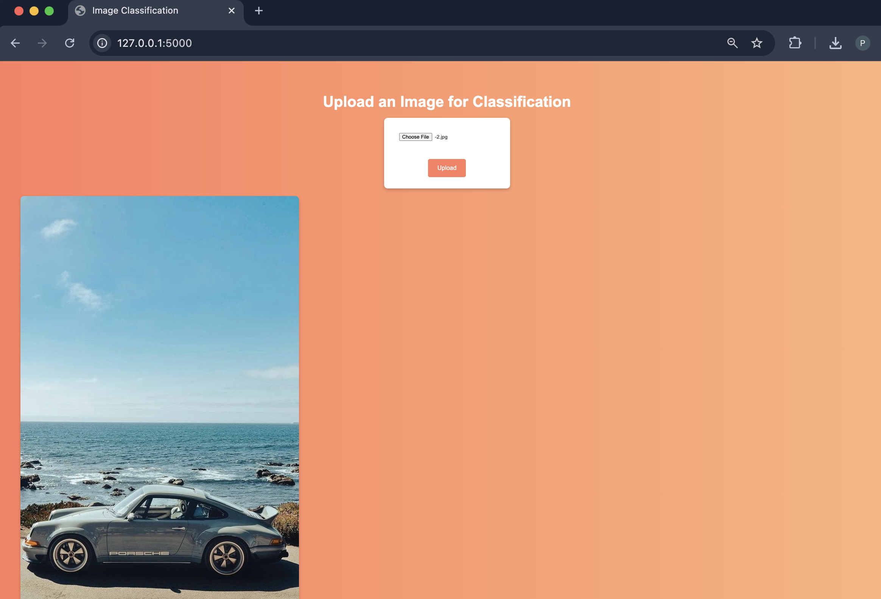

Slide 8
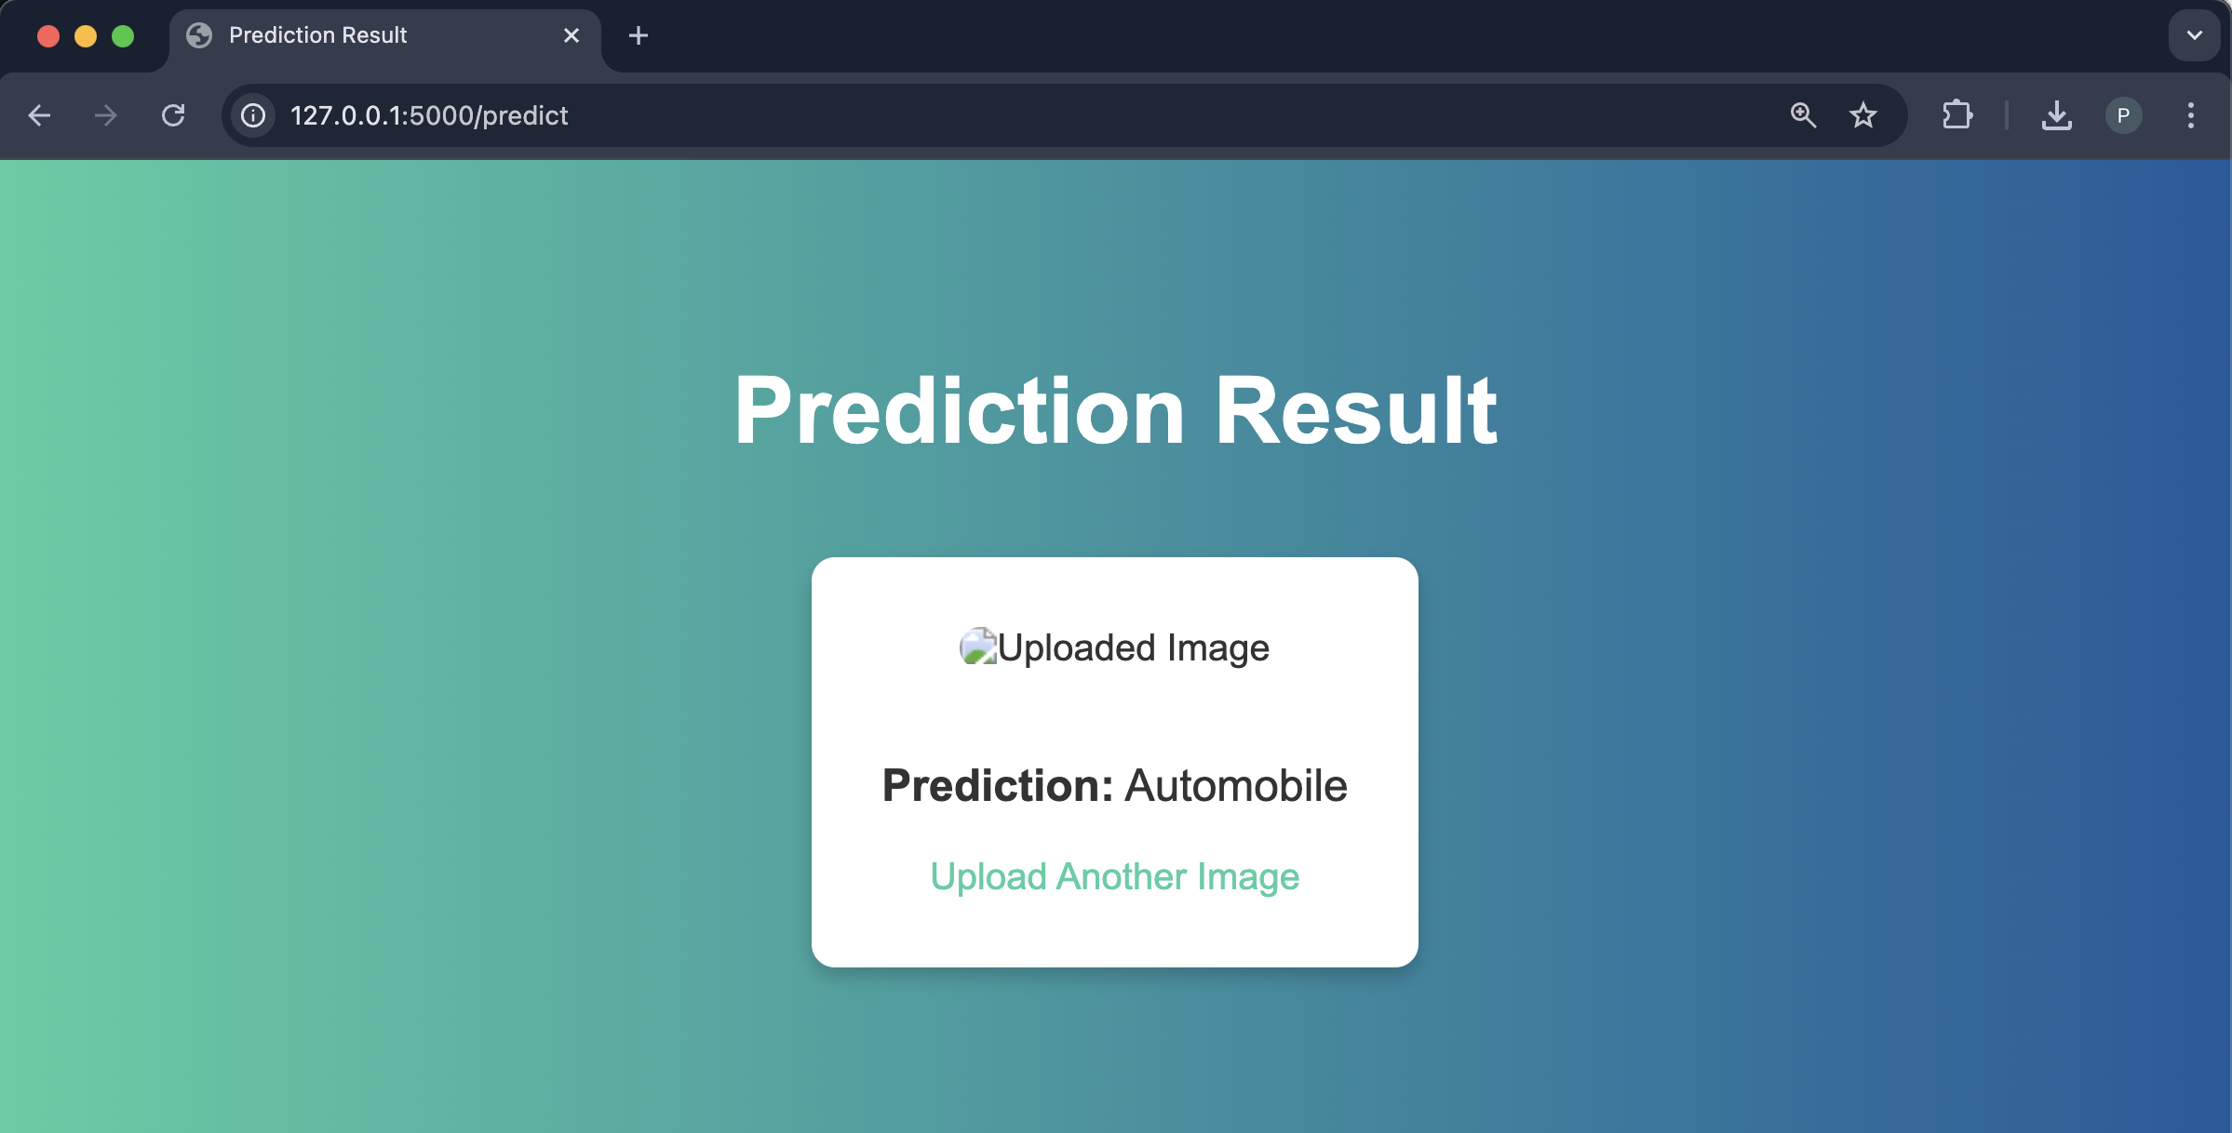

Slide 9
Challenges & Solutions
Challenges:
Handling Overfitting: Regularization and Data Augmentation.
Model Deployment: Integrating the trained model with Flask.
Solutions:
Applied L2 Regularization and Dropout layers.
Optimized Flask routes and image processing.

Slide 10
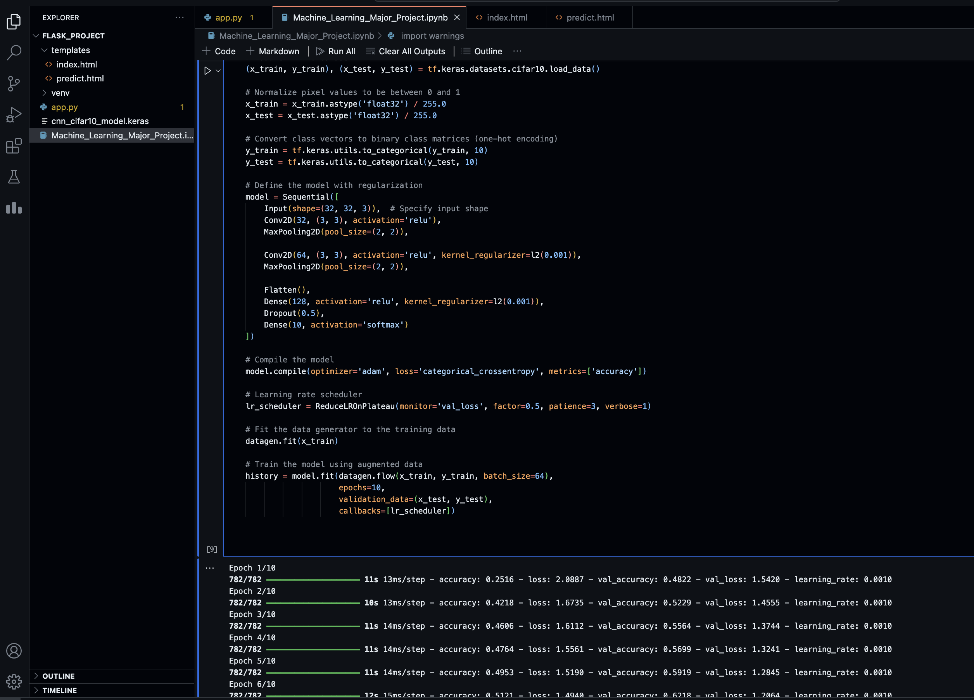
Conclusion
Project Summary:
Successfully built and deployed a CNN-based image classifier.
Achieved satisfactory accuracy on CIFAR-10 dataset.

